Slide 1

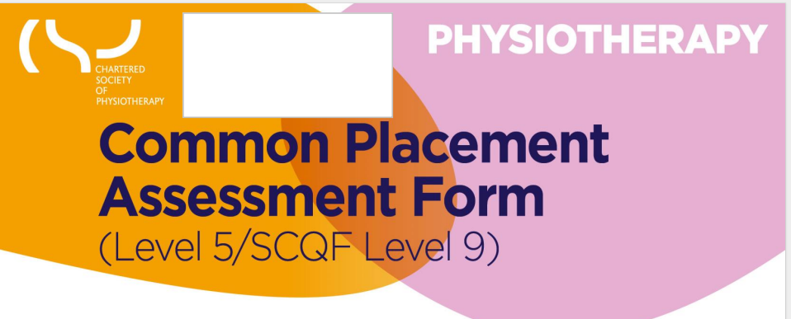
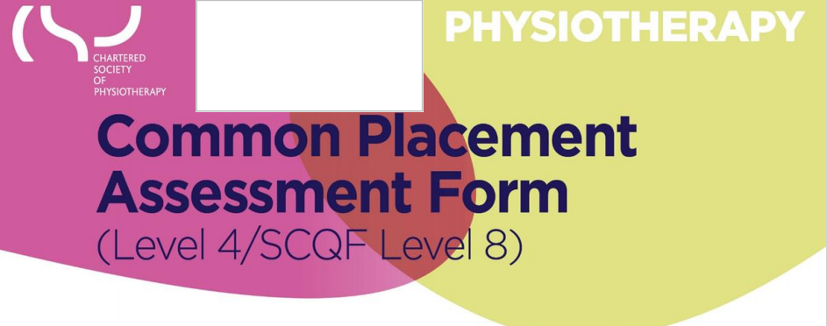

Exploring the CPAF Learning Domains
Ngozi Onuegbu PhD
PT5W50/PT4W50

Slide 2
Learning Objectives
Develop students' understanding of assessment in clinical placements.
Strengthen students’ knowledge of under pinning pedagogical reasoning that drives practice education
Enhance understanding of the role of professionalism, feedback and reflection in physiotherapy education.

Slide 3
What will be covered today?
Independent learning
Seeking, reflecting on and responding to feedback
Organisation and prioritisation
Communication
Working with others
Individuals, communities, and populations
Gathering and analysing information
Evidence based practice
Reasoning and intervention
Recording information

Slide 4
Introduction to Learning Domains in Physiotherapy Placements
Overview:
  The Common Placement Assessment Form (CPAF) outlines 10 core learning domains assessing clinical and professional competencies during placements.
Framework:
  These domains align with HCPC standards and CSP professional values, ensuring students are prepared for clinical practice (HCPC, 2023; CSP, 2011).
Pedagogical Insight:
  Biggs' (1996) Constructive Alignment emphasizes the need to align learning objectives, teaching methods, and assessments in clinical placements.

Slide 5
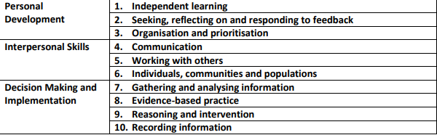
3 Key Learning Outcomes
Personal Development
Interpersonal Skills
Decision Making and Implementation

Slide 6

Personal Development – Independent Learning
Competency:
  Developing self-directed learning skills by actively seeking out learning opportunities and reflecting on clinical experiences.
HCPC Guidelines:
  HCPC (2023) emphasizes continual professional development and staying updated on physiotherapy advancements.
Pedagogical Framework:
  Kolb's (1984) Experiential Learning Cycle highlights "active experimentation," encouraging students to learn by doing in clinical environments.
Notes:
Identifying your own learning needs is really important. Why? Because
when you have done this, you are much more likely to change your
practice than if you were purely being ‘told what to do’. This process
can be challenging; but as it is personal to you, your motivation to learn
increases as a result.

Slide 7

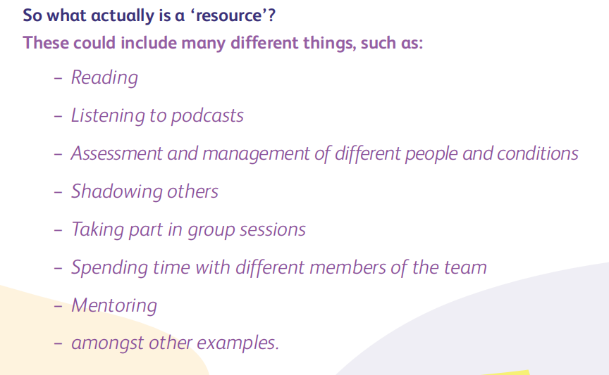

Slide 8
Personal Development – Seeking, Reflecting, and Responding to Feedback
Importance:
  Feedback fosters critical self-reflection, ensuring students improve their clinical practices (HCPC, 2014).
Assessment:
  Evaluates the ability to respond constructively to feedback and use it for skill development.
Pedagogical Insight:
  Gibbs' (1988) Reflective Cycle supports a structured approach to reflection, crucial in healthcare for refining clinical practices.
Notes:
As a student, your practice educator is there to guide and develop
you. They should provide you with regular feedback throughout
your placement and are key to helping you become a competent
physiotherapist. How you seek feedback, take it on board, reflect
and change your practice as a result is crucial.

Slide 9
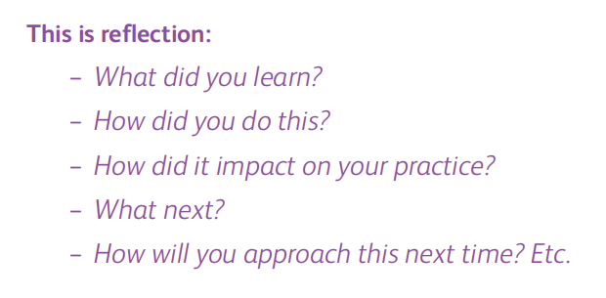


Slide 10
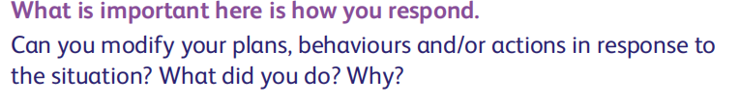
Personal Development – Organization and Prioritization
Competency:
  Effective time management and the ability to prioritize tasks are essential for patient care.
Assessment:
  Students are evaluated on how they organize patient care and balance clinical responsibilities.
CSP (2011) emphasizes prioritizing patient safety and treatment efficiency, while Moon (1999) supports reflective logs to improve organizational skills.
Notes:
Being organised means you are taking responsibility in planning your
own workload by prioritising the tasks that need to be completed first.
How can you do this? Think of it as a To-do list for the day; you may
want to rank the tasks in order of priority and add a deadline.

Slide 11

Interpersonal Skills – Communication
Key Competency:
  Effective communication with patients and healthcare teams is essential for successful outcomes.
Assessment:
  Evaluates clarity, empathy, and adaptability in verbal and non-verbal communication.
Theoretical Framework:
  Vygotsky’s (1978) Social Development Theory highlights communication’s role in collaborative learning and development.
Notes:
Communication is the most important skill of a physiotherapist.
It’s how we interact with people. When effective, it makes everybody’s
experience more positive; empowering others and building strong
relationships. When ineffective it does just the opposite.

Slide 12
Interpersonal Skills – Working with Others
Competency:
  Collaboration in multidisciplinary teams is key to integrated patient care.
Assessment:
  Evaluates teamwork, engagement in team meetings, and coordination with peers and other professionals.
Pedagogical Insight:
  Bandura’s (1977) Social Learning Theory suggests that students learn by observing and collaborating with others, vital in healthcare.
Who is in your Team?
What are their roles?
How can you work together?
Notes:
Who is in your team? This may include your practice educator, other
therapists, other medical professionals, support workers, reception and
admin staff and so on. Take time to get to know their unique roles and
what they bring to the team. This will enable you to better understand
both their contributions as well as yours – no matter the setting.

Slide 13
Interpersonal Skills – Individuals, Communities, and Populations
Competency:
  Understanding health disparities and providing inclusive care.
Assessment:
  Students must demonstrate adaptability to diverse patient needs, ensuring equitable care.
Pedagogical Reference:
  Mezirow’s (1991) Transformative Learning theory stresses the importance of critical awareness in addressing public health challenges.
Notes:
Many factors affect the health of individuals and communities. ‘Health is
complex - many factors affect the health of individuals and communities.’
• Genetics
• Ethnicity
• The physical environment
• The social environment
• Health related behaviours
If we think about these determinants we can really begin to understand
the effect they can have on an individual’s health, the health of a
community and even the health of populations.

Slide 14
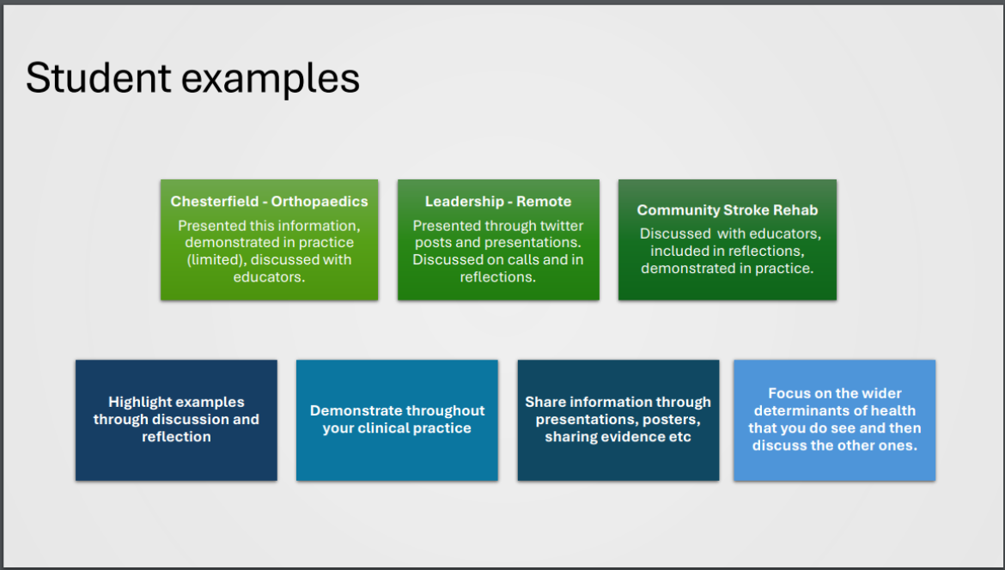

Slide 15
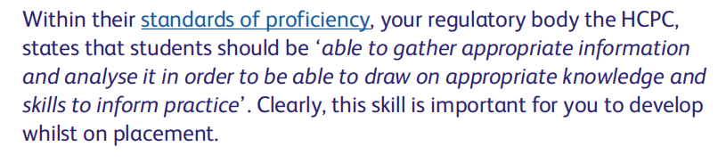
Decision Making and Implementation – Gathering and Analysing Information
Competency:
  Ability to collect and assess patient data to guide interventions.
Assessment:
  Evaluates students' ability to gather, analyse, and interpret patient information.
Sackett et al. (1996) Evidence-Based Medicine underlines the importance of combining clinical data with research evidence for decision-making.
Notes:
Think about what information you gather whilst on placement. This
may include subjective and objective assessments, literature searches,
polls, questionnaires and focus groups among many other examples.
This means that there is a lot of information for you to then analyse.

Slide 16
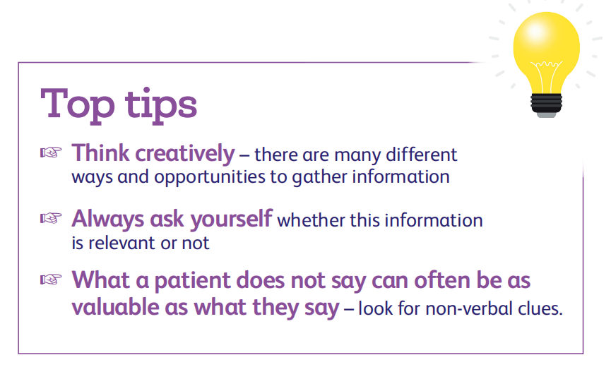

Slide 17
Decision Making and Implementation – Evidence-Based Practice
Competency:
  Using research evidence to inform clinical interventions.
Assessment:
  Students must demonstrate integration of current research into their clinical decision-making.
Pedagogical Framework:
  The Cochrane Collaboration (1999) promotes the use of systematic reviews to inform physiotherapy practices, ensuring evidence-based care.

Slide 18
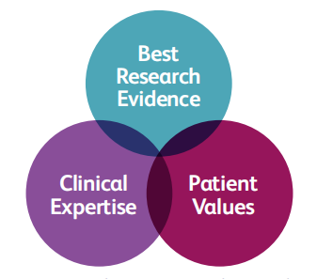

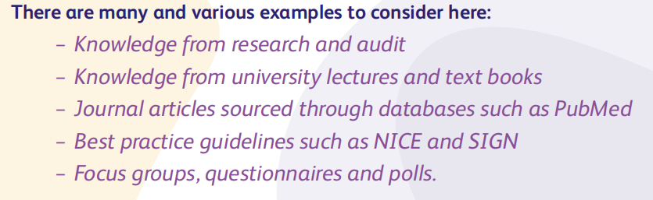

Slide 19
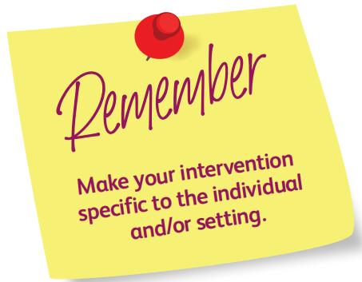
Decision Making and Implementation – Clinical Reasoning and Intervention
Competency:
  Demonstrating sound clinical reasoning to form treatment plans.
Assessment:
  Students are evaluated on their clinical decision-making and application of reasoning in patient interventions.
Pedagogical Insight:
  Schon’s (1983) Reflective Practitioner emphasizes reflective practice in clinical reasoning and decision-making, enabling students to refine their interventions.
Notes:
Reasoning is fundamental to physiotherapy practice and is a skill that we
will continue to develop as we learn and gain more experience. To put it
simply, this is your ability to analyse information, evaluate its meaning,
and decide the best course of action or intervention.

Slide 20
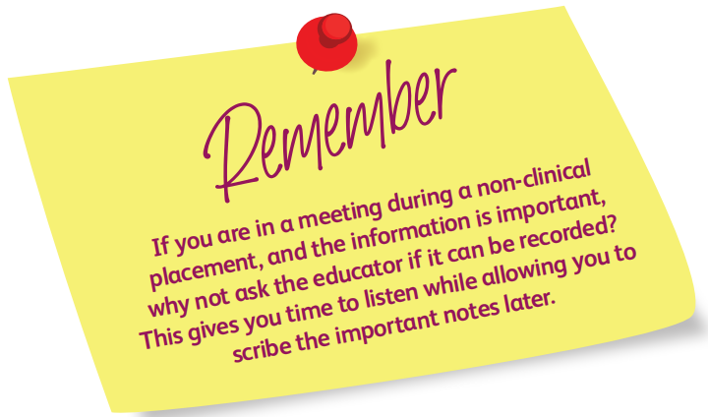
Decision Making and Implementation – Recording Information
Competency:
  Accurate documentation of patient care, ensuring clarity and legal compliance.
Assessment:
  Evaluates the completeness and professionalism of student documentation.
HCPC (2023) highlights that clear, accurate, and timely record-keeping is a fundamental responsibility of healthcare professionals.
Notes:
In a clinical placement, in person or remote, this includes your record
keeping – more commonly referred to as ‘patient notes’. Once qualified,
you will have a professional and legal obligation to keep an accurate
record of your interactions with patients. If no record is made, the law
may consider the events not to have happened.
This domain is also very relevant on a non-patient facing placement,
although it may be a bit trickier for you to picture how. We will explore
this together and discuss how we make sure our recorded information
is organised, understandable and accurate below.

Slide 21
Professionalism and Learning Domains
Competency:
  Demonstrating professionalism consistently across all domains.
Assessment:
  Students must show respect, accountability, and adherence to ethical and legal standards in clinical practice (HCPC, 2023).
CSP (2011) and HCPC (2023) stress professional behaviours such as confidentiality, punctuality, and adherence to ethical guidelines.

Slide 22
Continuous Feedback and Reflective Practice
Competency:
  Engaging with feedback for continuous self-improvement and professional growth.
Assessment:
  Continuous assessment is vital for developing self-reflection and integrating feedback to improve clinical practice (Kolb, 1984).
Pedagogical Insight:
  Boud, Keogh, and Walker (1985) argue that reflection turns clinical experience into learning opportunities, ensuring growth in professional practice.

Slide 23
Conclusion
The CPAF Learning Domains offer a structured framework for evaluating physiotherapy students during placements, focusing on skills such as:
clinical reasoning,
teamwork,
communication, and
professional conduct.

Slide 24
References:
Boud, D., Keogh, R. and Walker, D., 1985. Reflection: Turning Experience into Learning. London: Kogan Page.
Chartered Society of Physiotherapy (CSP), 2011. Code of Professional Values and Behaviour. [online] Available at: https://www.csp.org.uk/publications/code-professional-values-behaviour [Accessed 9 September 2024].
Gibbs, G., 1988. Learning by Doing: A Guide to Teaching and Learning Methods. Oxford: Oxford Polytechnic.
Health and Care Professions Council (HCPC), 2014. Standards of Education and Training. [online] Available at: https://www.hcpc-uk.org/standards/standards-of-education-and-training/ [Accessed 9 September 2024].
Health and Care Professions Council (HCPC), 2023. Standards of Conduct, Performance and Ethics. [online] Available at: https://www.hcpc-uk.org/standards/standards-of-conduct-performance-and-ethics/ [Accessed 9 September 2024].
Kolb, D.A., 1984. Experiential Learning: Experience as the Source of Learning and Development. Englewood Cliffs, NJ: Prentice Hall.
Mezirow, J., 1991. Transformative Dimensions of Adult Learning. San Francisco: Jossey-Bass.
Sackett, D.L., Rosenberg, W.M.C., Gray, J.A.M., Haynes, R.B. and Richardson, W.S., 1996. Evidence-Based
Medicine: What It Is and What It Isn’t. BMJ, 312(7023), pp.71-72.
Schon, D.A., 1983. The Reflective Practitioner: How Professionals Think in Action. London: Temple Smith.
Vygotsky, L.S., 1978. Mind in Society: The Development of Higher Psychological Processes. Cambridge, MA: Harvard University Press.

Slide 25
Any Questions?

